Slide 1
Production and Production Function
1

Slide 2


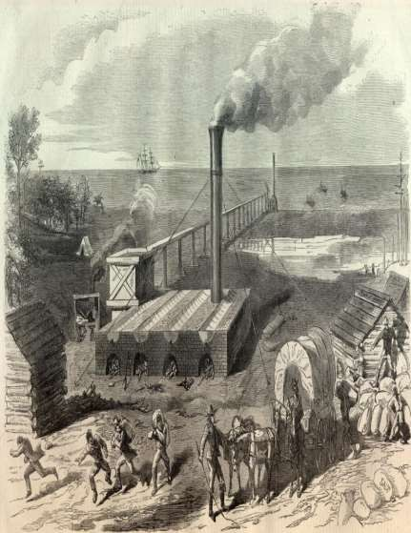

It’s an activity that transforms
input into output.

Slide 3



Inputs
Capital Entrepreneurship Land
Labour
Process
Output
Product or service
generated
A production function can be an equation,table or graph presenting the maximum amount of a commodty that a firm can produce from a given set of inputs during a period of time.

Slide 4


•••••••P••r•o•d•u••c•t•i•o•n••f•u•n•c••ti•o•n•••
The production function can be mathematically written as:
Q = f(L, K, T…..n)
Where,
Q = output L = labour K = capital
T = level of technology
n = other inputs employed in production

Slide 5



How to obtain Maximum output
Helps the producers to determine whether employing variable inputs /costs are profitable
Highly useful in longrun decisions
Least cost combination of inputs and to produce an output

Slide 6
Cobb-Douglas Production Function:
Paul H.Douglas and C.W Cobb of the U.S.A have studied the production of the american manufacturing industries and they formulated a statistical production function.
Empirical estimation is the power function of the form :
Q = ALª K^{b}
where,
Q = Output
L = Labour K = capital
A, a and b are positive constants.

Slide 7

Types
Short –Run
(Inputs kept constant
One input (Labour) is varied)
Long – Run
(Varying all inputs)
Law of variable proportion
Law of returns to scale

Slide 8
Law of Variable Proportions
2
This law was given by Alfred Marshall in his book Principle of Economics.
It show particular pattern of change in output when some factors remain fixed.
Production depend upon factors of production , if factors of production are good, production may increase and vice-versa.
Production function show functional relationship between Output and factors of production.

Slide 9
The production function has two inputs:
3
Q=F(K,L)
Where, Q=production
K=fixed factor
L= variable factor

Slide 10
TOTAL PRODUCT
4
Total product /total physical product is a total amount of good produced by the producer by using a particular or given amount of labour or input during a particular period of time.
TP=SUM MP
TP first increase with increasing rate, then increase with decreasing rate become constant and then reduce.

Slide 11


AVERAGE PRODUCT
It is the amount of goods produced by per unit of labour.
AP=TP/L
5

Slide 12
MARGINAL PRODUCT
6
It is the extra production done by the producer by employing an additional unit of labour.
MP= TPn- TPn-1

Slide 13
ASSUMPTION OF LAW OF VARIABLE PROPORTION
7
. It operates in short run, as factors are classified as variable and fixed factor;
. This law applies to the field of production only;
The effect of change in output due to change in variable factor can be easily determined;
The law applies to all fixed factors including land;
. The state of technology is assumed to be constant during the operation of this law;
It is assumed that all variable factors are equally efficient.

Slide 14
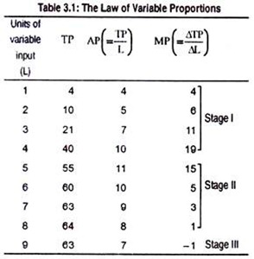

Slide 15
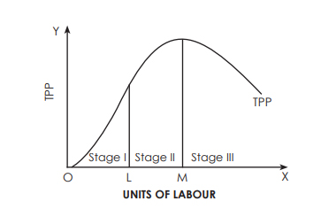
10

Slide 16
STAGES OF LAW OF VARIABLE PROPORTION
8
1 stage:
It is called law of increasing return. In this stage TP increase with increasing rate and MP increases and reaches maximum.
Point lying on TP curve is called point of inflexion. It is that point where TP change it slope and MP is maximum.
This stage is called law of increasing return becoz MP is increasing.

Slide 17
11
Stage 2: It is called law of diminishing returns. At this stage TP increase with decreasing rate and become constant and maximum and MP reduces become zero. This is known as law of diminishing returns because MP is reducing.
Stage 3:
This stage is called Law of Negative Returns. At this Stage Total Productivity reduces and Marginal Productivity becomes negative.

Slide 18
CAUSES OF LAW OF INCREASING RETURNS
13
DUE TO BEST UTILISATION OF FIXED FACTOR-
At initial stage supply and contribution of fixed factors is more as compared to variable factor or the fixed factors are not utilised fully so giving its best contribution to increase the production.

Slide 19
 EFFICIENCY OF VARIABLE FACTORS DUE TO DIVISION OF LABOUR AND SPECIALISATION
14
variable factors in first stage are working efficiently as there are few labours which makes coordination easy and thus increases the production.

Slide 20
CAUSES OF DECREASING OR NEGATIVE RETURNS
15
OPTIMUM UTILISATION OF FIXED FACTORS OF PRODUCTION
In 2 and 3 stage it is assume fixed factors are utilised optimally due to optimum utilisation of fixed factors total production starts reducing because fixed factors have already attributed its fullest to production process and has no more capacity to increase production.

Slide 21
LACK OF COORDINATION AMONG VARIOUS FACTORS
16
In 2 and 3 stage as the number of labour increases the coordination among them reduces and due to this total production increases with decreasing rate and ultimately reduces. As lack of coordination leads to mutual conflicts , strikes, lockout.

Slide 22





Law of Returns to Scale
It is a Long run analysis & all factors are variable.
It seeks to analyse the effects of scale on the level of output.
Three kinds of returns to scale:
INCREASING RETURNS TO SCALE
CONSTANT RETURNS TO SCALE
DECREASING RETURNS TO SCALE

Slide 23
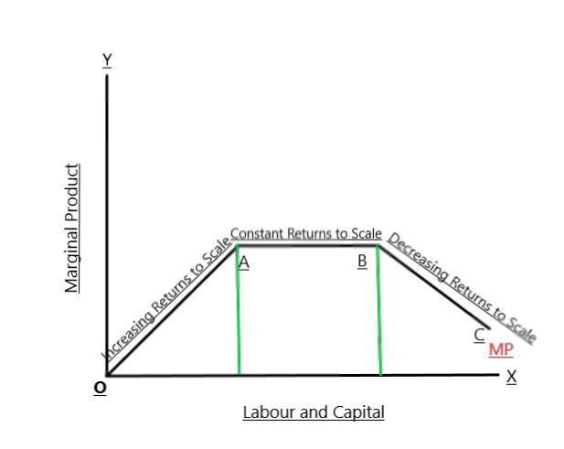

Slide 24


ISOQUANTS
Isoquant is a curve representing the various combinations of two inputs that produce the same amount of output. Also called as equal product curve.
Slope of an isoquant indicates the rate at which factors K and L can be substituted for each other while a constant level of production is maintained.
ASSUMPTIONS :
There are two inputs: Labour L & Capital C to produce a commodity X.
L,K & X are Perfectly divisible.

Slide 25
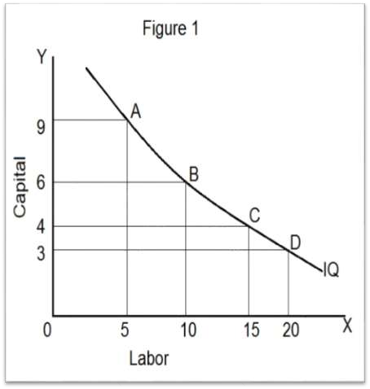

Example:
Factor Production | Labour | Capital
A | 5 | 9
B | 10 | 6
C | 15 | 4
D | 20 | 3
E | 25 | 2

Slide 26
ISOCOSTS
1.Isocosts refers to the cost curve that represents the
combination of inputs that will cost the producer the
same amount of money i.e each isocost denote
particular level of total cost for a given level of
production.
2.If the level of production changes, the total cost
changes and thus the isocost curve moves upward
and vice versa.
3.Any change in input prices changes the slope of
isocost lines.
4.Slope of isocost line is = -P(L)/P(K).
5.Points of tangency determines the least cost combination

Slide 27
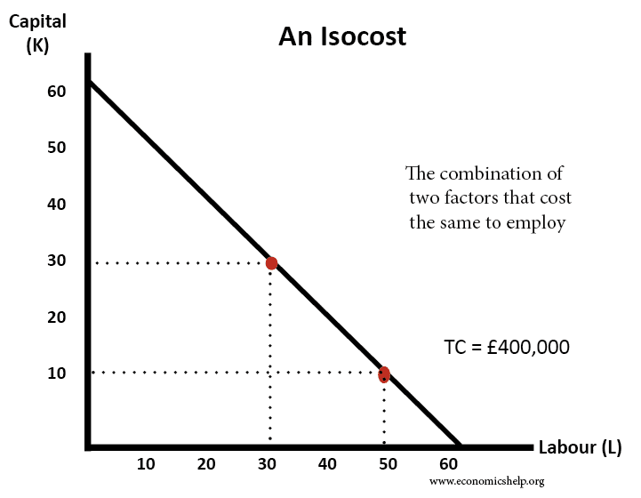

Slide 28
MRTS (Marginal Rate of Technical Substitution)
The MRTS refers to the rate by which one input factor is substituted with the other to attain a given level of output.
-> When two factors of production labor and capital are employed then MRTS of capital for labor is no of labors which can replaced by one unit of capital usually the combination of capital and labor are MRTS.
->MRTS are the Isoquants where input factors are perfect substitutes as shown in the graph and they are called Linear Isoquants .

Slide 29
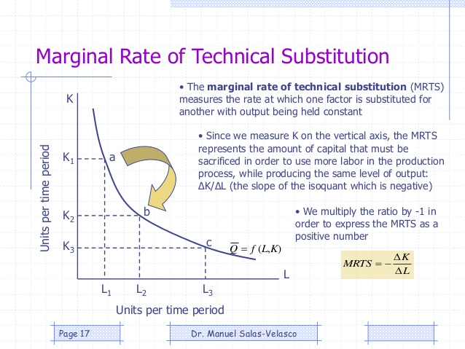

Slide 30
Thank you

